Slide 1
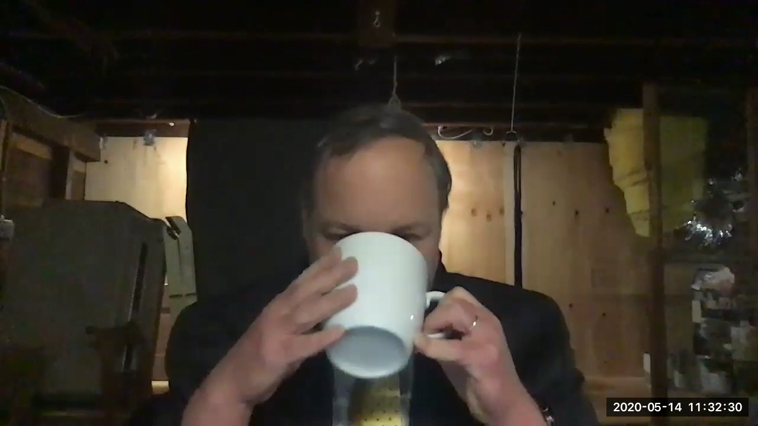
Video Introduction: 0. As Class Begins…
Link
Welcome!: How do we learn? Especially now, with COVID-19, when we are online? We need an answer to that question if we are not going to make a hash of this… & what is economics? What is it good for? <https://www.icloud.com/keynote/0hKUPRSiDeqytMrEOMgwWUebA> <https://github.com/braddelong/public-files/blob/master/video-module-0-intro-2020-05-14.mp4> <https://www.youtube.com/watch?v=AnSjX8ClAXQ> <https://www.bradford-delong.com/2020/05/intro-how-do-we-learn-online-especially.html>
1:37 of video
Notes:
Welcome. I am Brad DeLong.
Videos are arresting. Videos are essential. But videos are also a pale shadow of and thus much more boring than in person presence.
It is, therefore, hard to maintain engagement without superb actors and an entire focused team of Hollywood professionals.
So let me be brief:
I am recording this from my basement in the spring of coronavirus, as American universities frantically pile online so that we can keep teaching. And as we do so we face an intellectual crisis.
The intellectual crisis is this:
Universities got their start, back when books were really expensive, as the only places you could read lots of books (in the library) and listen to lots of books being read aloud (in the lectures). But then came Johann Gutenberg, and books became really cheap. You could have your library, and read your books, almost anywhere.
Yet universities did not disappear.
Rather, over the past half millennium, they have flourished.
Why?
Unless and until we successfully answer that question, we are going to make a total hash of moving online. Here I take a stab at suggesting possible answers to this “why?” question.
And here I also ask and suggest some possible answers to the questions: what is economics? And: what is economics good for?
Once again: welcome. I very much hope you have fun here. I very much hope you learn stuff here.
——
<https://github.com/braddelong/public-files/blob/master/video-module-0-intro-2020-05-14.mp4>
<https://www.youtube.com/watch?v=AnSjX8ClAXQ>
Intro: How Do We Learn (Online Especially)?: Video <https://www.bradford-delong.com/2020/05/intro-how-do-we-learn-online-especially.html>

Slide 2
Video Introduction Text
Welcome. I am Brad DeLong.
Videos are arresting. Videos are essential. But videos are also a pale shadow of and thus much more boring than in person presence.
It is, therefore, hard to maintain engagement without superb actors and an entire focused team of Hollywood professionals.
So let me be brief:
I am recording this from my basement in the spring of coronavirus, as American universities frantically pile online so that we can keep teaching. And as we do so we face an intellectual crisis.
The intellectual crisis is this:
Universities got their start, back when books were really expensive, as the only places you could read lots of books (in the library) and listen to lots of books being read aloud (in the lectures). But then came Johann Gutenberg, and books became really cheap. You could have your library, and read your books, almost anywhere.
Yet universities did not disappear.
Rather, over the past half millennium, they have flourished.
Why?
Unless and until we successfully answer that question, we are going to make a total hash of moving online. Here I take a stab at suggesting possible answers to this “why?” question.
And here I also ask and suggest some possible answers to the questions: what is economics? And: what is economics good for?
Once again: welcome. I very much hope you have fun here. I very much hope you learn stuff here.
——
<https://github.com/braddelong/public-files/blob/master/video-module-0-intro-2020-05-14.mp4>
<https://www.youtube.com/watch?v=AnSjX8ClAXQ>
Intro: How Do We Learn (Online Especially)?: Video <https://www.bradford-delong.com/2020/05/intro-how-do-we-learn-online-especially.html>
234 words; 1:37 of video
Notes:
Welcome. I am Brad DeLong.
Videos are arresting. Videos are essential. But videos are also a pale shadow of and thus much more boring than in person presence.
It is, therefore, hard to maintain engagement without superb actors and an entire focused team of Hollywood professionals.
So let me be brief:
I am recording this from my basement in the spring of coronavirus, as American universities frantically pile online so that we can keep teaching. And as we do so we face an intellectual crisis.
The intellectual crisis is this:
Universities got their start, back when books were really expensive, as the only places you could read lots of books (in the library) and listen to lots of books being read aloud (in the lectures). But then came Johann Gutenberg, and books became really cheap. You could have your library, and read your books, almost anywhere.
Yet universities did not disappear.
Rather, over the past half millennium, they have flourished.
Why?
Unless and until we successfully answer that question, we are going to make a total hash of moving online. Here I take a stab at suggesting possible answers to this “why?” question.
And here I also ask and suggest some possible answers to the questions: what is economics? And: what is economics good for?
Once again: welcome. I very much hope you have fun here. I very much hope you learn stuff here.
——
<https://github.com/braddelong/public-files/blob/master/video-module-0-intro-2020-05-14.mp4>
<https://www.youtube.com/watch?v=AnSjX8ClAXQ>
Intro: How Do We Learn (Online Especially)?: Video <https://www.bradford-delong.com/2020/05/intro-how-do-we-learn-online-especially.html>

Slide 3
Catch Our Breath…
Ask a couple of questions?
Make a couple of comments?
Any more readings to recommend?
<>

Slide 4
U.C. Berkeley: Economics 115: Fall 2020
The World Economy in the Long 20th Century: 1870-2016
Brad DeLong
Department of Economics & Blum Center, U.C. Berkeley; & WCEG
delong@econ.berkeley.edu
last revised: 2020-05-23
for delivery: 2020-08-29
Fall 2020 instantiation: <https://bcourses.berkeley.edu/courses/1493152>
On github: <https://github.com/braddelong/public-files/blob/master/econ-115-master.pptx>
Master file: <https://www.icloud.com/keynote/0oWNqxKlrwJZn8H1UbIfG-LBg>

Slide 5

Modules
Notionally: a sixteen week semester—the last week being review, & the first week getting off to a somewhat ragged start…
0. As class begins… <<https://www.icloud.com/keynote/0FVJH3UuqPuq91KpU0jRc1vRQ>
Themes
Growth & globalization 1870-1914
Empire & underdevelopment: 1870-1914
World War I & failed reconstruction: 1907-1929
The Great Depression: 1925-1941
Alternatives to the ‘classical liberal’ order: 1870-2016
World War II & cold war: 1933-1989
30 glorious years in the global north: 1945-1975
False (& true) starts to development in the global south: 1911-1990
The neoliberal turn: 1980-2005
Hyperglobalization & infotech: 1955-2016
The great recession & secular stagnation: 2005-2016
East Asia’s rise: 1870-2016
Ending the long 20th century: 2005-2016
Conclusion: looking back & looking forward: -3000-3000
Link
Link

